Slide 1
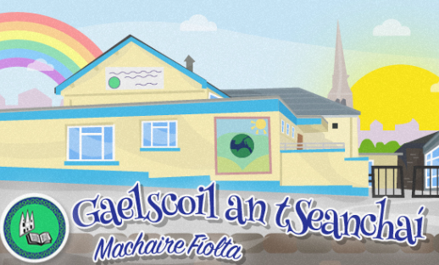
Nuair a thagann tú ar ais chun na scoile
Rang 1 2020
Múinteoir Daniel

Slide 2

Tá an Béar Beag ag tosú ar an scoil. Ní raibh sé ann ar feadh tamaill.
Little bear is starting school, he hasn’t been there for a while.
Fáilte ar ais!
Tá a fhios ag Béar Beag go mbeidh rudaí giota beag difriúil ar scoil, ach tá sé ag dúil go mór le bheith ar ais. Bhí sé ag labhairt le Múinteoir s’aige, agus dúirt sé…
Little bear knows that things may be a little different at school, but he is really excited to start! He was talking to his teacher about starting school and here’s what he said…

Slide 3
Nuair a thagann tú ar ais…
When you come back to school…
…b’fheidir go mbeidh seomra nua agat.
You may have a new classroom
Ach beidh cuid mhór rudaí mar an gcéanna, beidh an seomra go fóill lán le grá agus le gáire, díreach mar a bhí sé.
Lots of things are still the same – your room will still be full of love and laughter, just like it always was.

Slide 4
Nuair a thagann tú ar ais…
When you come back to school…
B’fheidir nach mbeidh na bréagáin chéanna uilig ann.
…some of the toys may not be where they used to be.
Tá na bréagáin go fóill ann, ach beidh siad ar shiúl ar feadh tamaill chun deis a thabhairt dúinn bheith ag súgradh le rudaí suimiúla eile. Beidh an-spraoi againn!
We still have them, they have just been packed away for a little while so that we can explore other toys in our room. We’ll still have lots of fun!

Slide 5
Nuair a thagann tú ar ais…
When you come back to school…
…Tá sé tábhachtach do lámha a ní go maith agus go minic
…we’ll have to remember to wash our hands during the day
Tá a fhios agam go bhfuil tú fíormhaith ag níomh na lámha, coinnigh ag dul! Nigh, nigh agus nigh arís!
You have become an expert at washing your hands now so we just need to keep this up! Wash, wash, wash!

Slide 6
Nuair a thagann tú ar ais…
When you come back to school…
Tá seans nach mbeidh gach duine ann ó Naíscoil ach beidh cuid mhór daoine eile ann, atá cineálta agus cairdiúil agus atá ag dúil go mór le bualadh leat.
…some of your friends might be at home for a little while. Lots of things are still the same – we are all still friends and we still care about each other and think about each other, even when we’re not together.

Slide 7
Nuair a thagann tú ar ais…
When you come back to school…
Beidh an lá scoile beagáinín difriúil. Ní bheidh deis againn bheith ag súgradh le páistí eile ó ranganna eile, ach ní mhairfidh sin ach ar feadh tamaillín, go dtí go bhfuil muid uilig socruithe agus sona sásta ar scoil.
…the school day might feel a little bit different for a while. We might not be able to play with our friends from other classes. This will just be for a while so that we can all get used to being back at school.
Go ceann tamaill, beidh seomra s’againne cosúil le bolgán. Thig linn bheith ag súgradh agus ag foghlaim taoibh istigh den bholgán
For now, our room will be like our own little bubble. We can play, learn, have fun and care about each other inside our bubble

Slide 8
Nuair a thagann tú ar ais…
When you come back to school…
Beidh do mhúinteoir ranga chomh sásta tú a fheiceáil. Chrónaigh gach duine sa scoil thú. Ní thig le do mhúinteoir fanacht go dtí go bhfuil sibh ag ceol, ag súgradh agus ag léamh scéalta le chéile.
…your teacher will be so pleased to see you. They have missed you and can’t wait to play, sing songs, read stories and have fun!
Beidh na daoine fásta uilig ag tabhairt áire duit, cosúil le do mhamaí agus do dhaidí.
The grown-ups in your room will look after you and keep you safe, just like your family do.

Slide 9
Nuair a thagann tú ar ais…
When you come back to school…
Bain sult as! B’fheidir go bhfuil tú néirbhíseach faoin ach beidh an scoil go fóill lán le grá, le spraoi agus le cairdeas, cé go mbeidh sé difriúil.
have fun! It may feel a little bit strange to begin with but school is still full of fun, love and friendship – even if it looks a little bit different.

